Slide 1



Lot 29, Block 27, Green Valley, San Nicolas III, Bacoor, Cavite

Slide 2
Table of Contents:
-About Us
-Vision & Mission
-Organizational Chart
-Our Products
-Product Packaging
-Sachet
-Box
-Facilities
-Permits & Licenses
-Contact Us

Slide 3
About Us
Café Gusto, a subsidiary brand of The Manila Times Group of Companies, presents a delightful 3-in-1 coffee experience, offering a trio of distinct flavors to satisfy your coffee cravings: Clasico, White, and Brown.
Café Gusto’s 3-in-1 coffee drinks are crafted to cater to diverse palates, ensuring that every sip delivers a unique and satisfying coffee experience. Discover your favorite flavor today and elevate your coffee moments with Café Gusto.

Slide 4
Vision & Mission
Vision
To see the day when thenceforth Filipinos shall have attained excellent unity, proud in proclaiming from generation to generation: one nation, one coffee.
Mission
To make coffee drinking a distinct identity of the Filipino lifestyle that satisfies the nation's craving for excellence in all its artful undertakings.

Slide 5
Organizational Chart
Mr. Dante A. Ang
President
Mr. Michael Ang
General Manager
Ms. Joana Paula Ang
General Manager

Slide 6
Organizational Chart
Anie
Navarro
QA/QC Officer
Mr. Michael Ang
General Manager
Christine
Quintans
R&D Specialist
Michael
Moral
Warehouse Supervisor
Nelson
Lu
Sales & Marketing Head
Marlon
Saludo
Production Supervisor

Slide 7
Production Department
Dennis
Villaluz
Production
Operator
Mr. Marlon
Saludo
Production Supervisor
Clemente
Marmol
Production
Operator
Marites
Perez
Production
Operator
James Daniel
Giron
Production
Operator
Riza
Sanchez
Production
Operator

Slide 8
QA/QC Department
Nenita
Damiano
Housekeeping & Sanitation Personnel
Ms. Anie
Navarro
QA/QC Officer

Slide 9
Warehouse Department
Archie
Hermo
Warehouse Personnel
Mr. Michael
Moral
Warehouse Supervisor
Rezille
Ramirez
Warehouse Personnel

Slide 10
Sales & Marketing Department
Paul Mathew R. Gozo
Marketing Staff
Mr. Nelson
Lu
Sales & Marketing Department

Slide 11
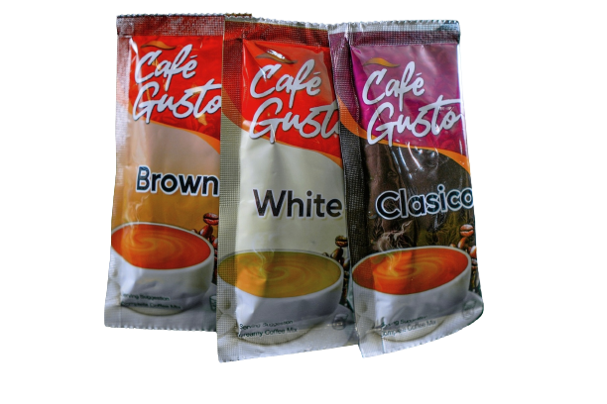
Our Products
Café Gusto’s 3-in-1 coffee drinks are crafted to cater to diverse palates, ensuring that every sip delivers a unique and satisfying coffee experience. Discover your favorite flavor today and elevate your coffee moments with Café Gusto.

Slide 12
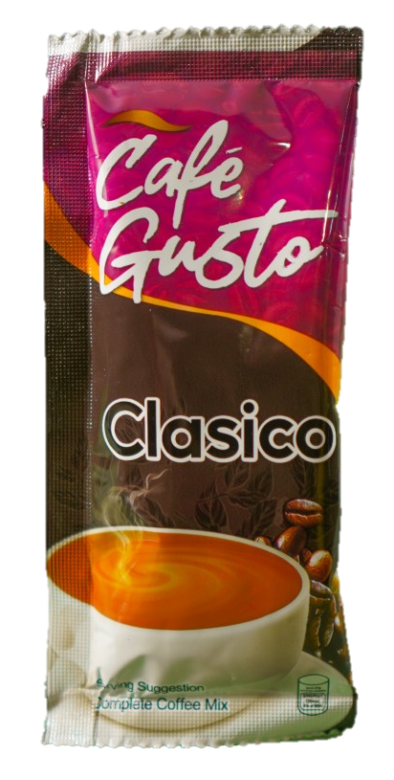
Our Products
Product Name:
Café Gusto 3-in-1 Clasico Coffee Powder Mix
Description:
Immerse yourself in the rich, classic coffee flavor of Clasico. This blend strikes the perfect harmony between sweetness and creaminess, creating a delightful and robust coffee indulgence.

Slide 13
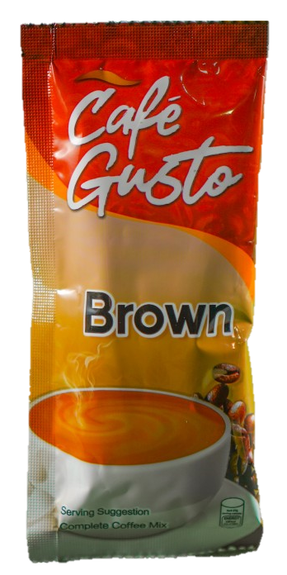
Our Products
Product Name:
Café Gusto 3-in-1 Brown Coffee Powder Mix
Description:
Dive into the exquisite taste of our Brown coffee powder mix characterized by a caramel-like sweetness that expertly counterbalances the robust coffee notes. This blend offers a harmonious fusion of sweetness and coffee depth.

Slide 14
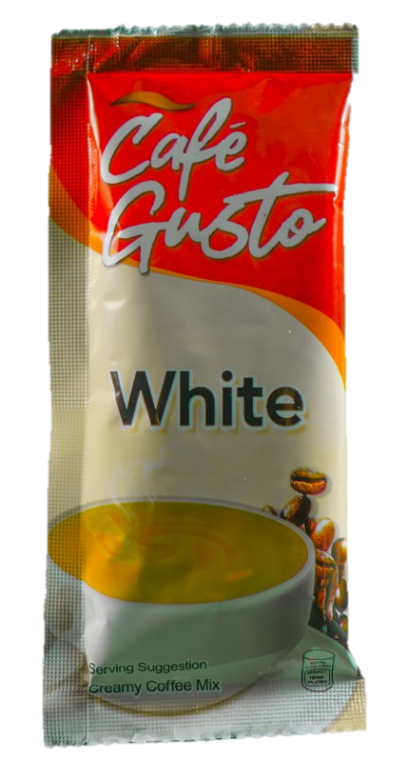
Our Products
Product Name:
Café Gusto 3-in-1 White Coffee Powder Mix
Description:
For those seeking a velvety coffee experience, our White coffee powder mix delivers a creamy blend that beautifully complements the bold coffee essence without overwhelming it. It’s the perfect balance of coffee and creaminess.

Slide 15
Product Packaging

Slide 16
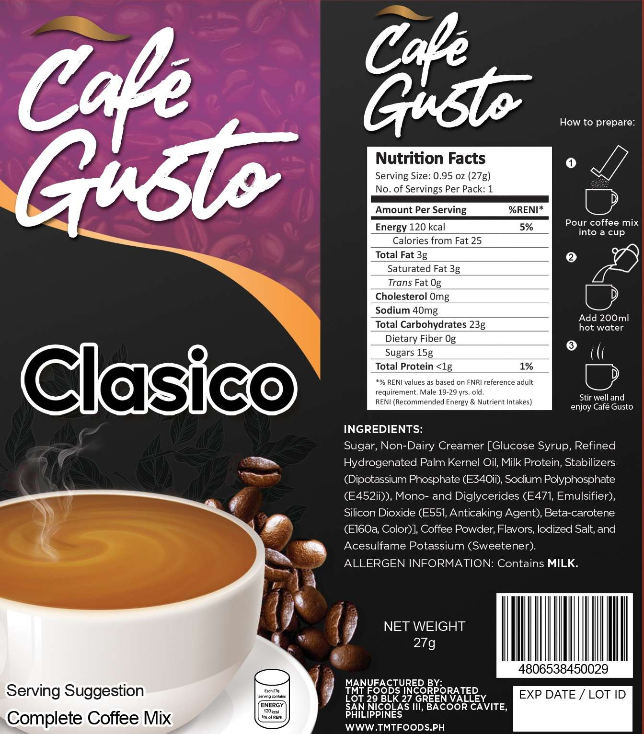
Café Gusto Clasico
(Sachet)

Slide 17
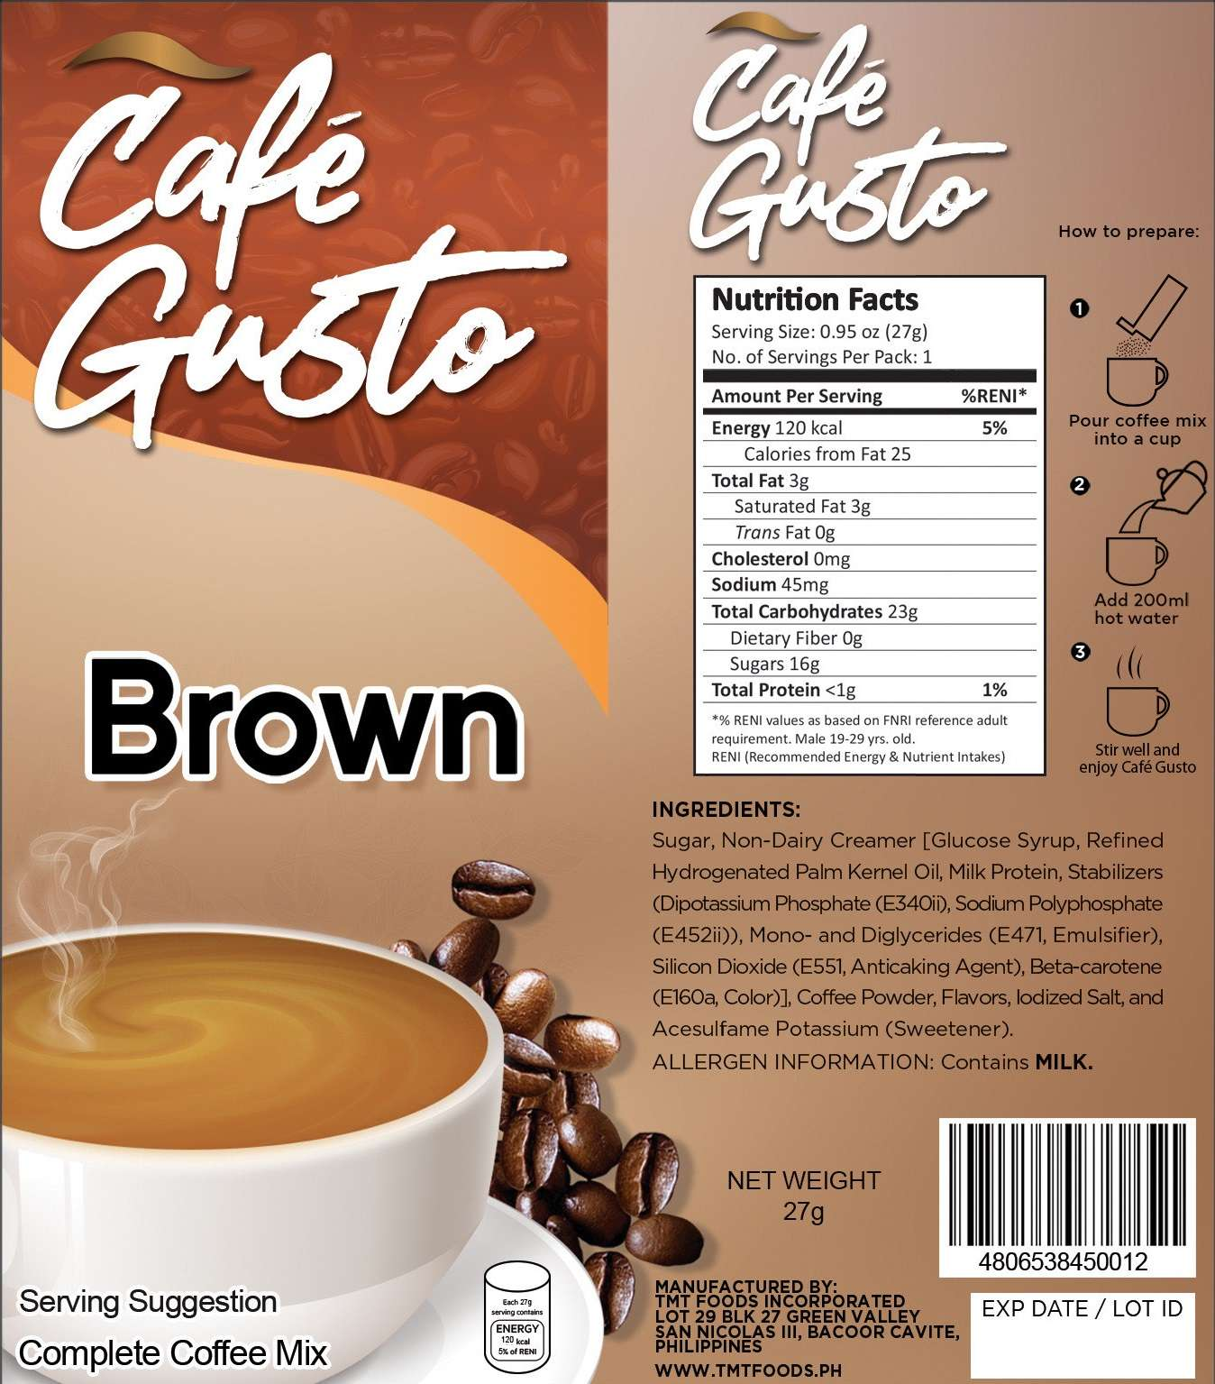
Café Gusto Brown
(Sachet)

Slide 18
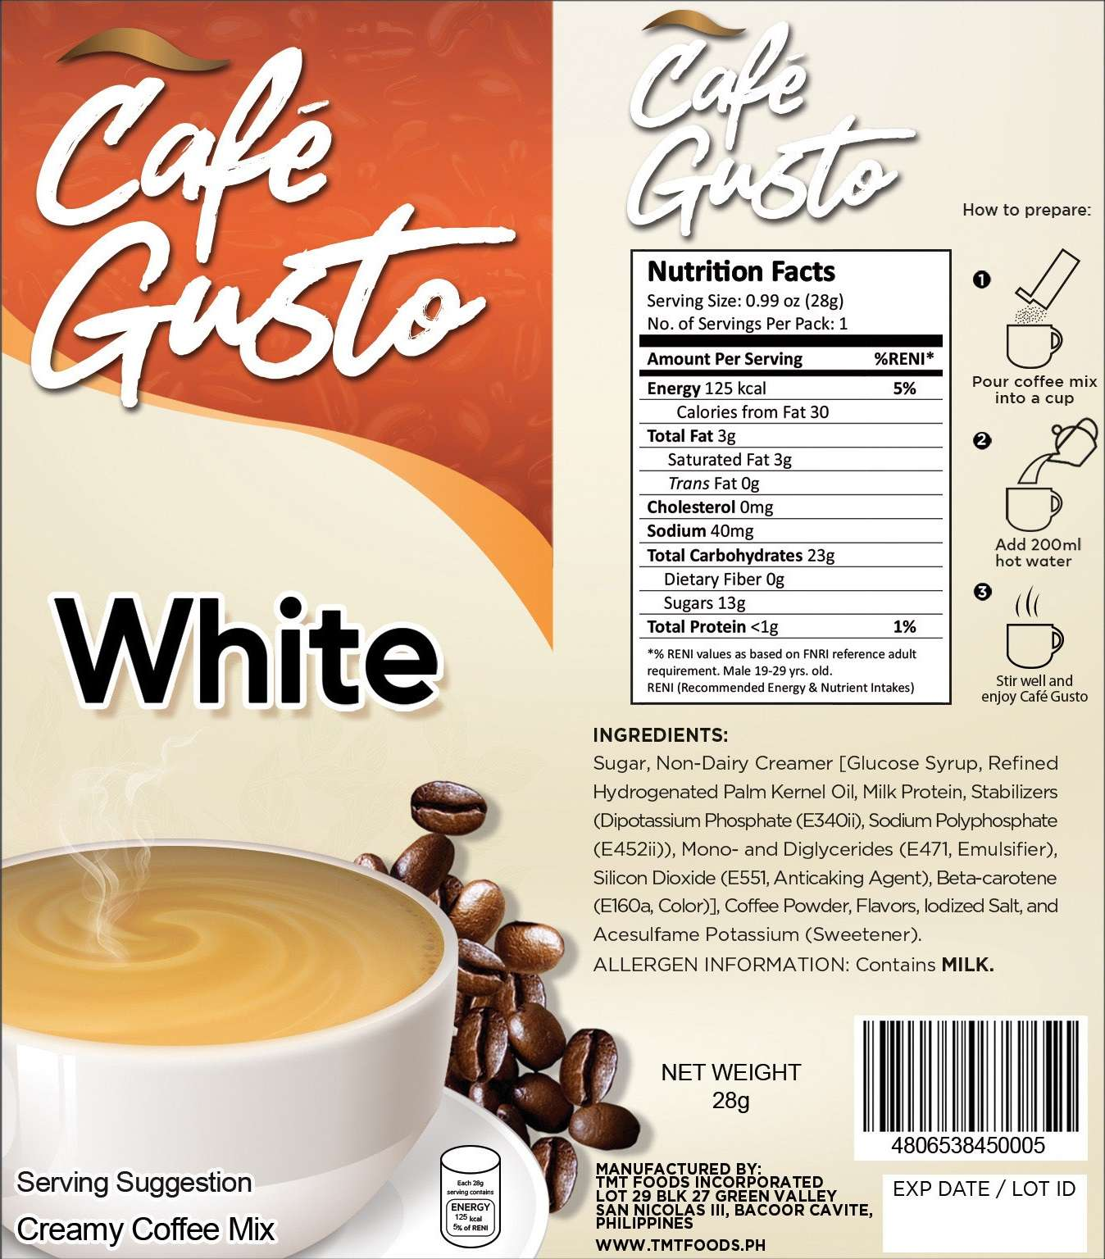
Café Gusto White
(Sachet)

Slide 19
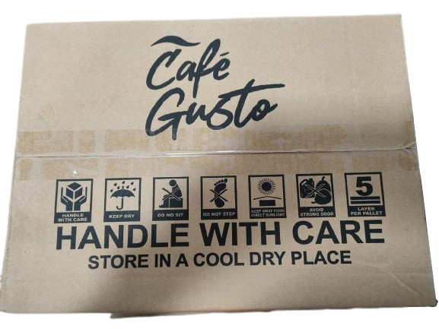
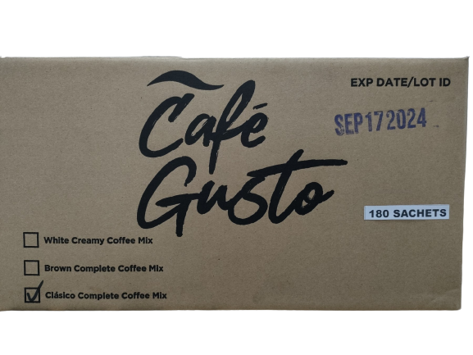
Café Gusto Actual
Box
Size (LxWxH)
390mm x 280mm x 208mm O.D

Slide 20
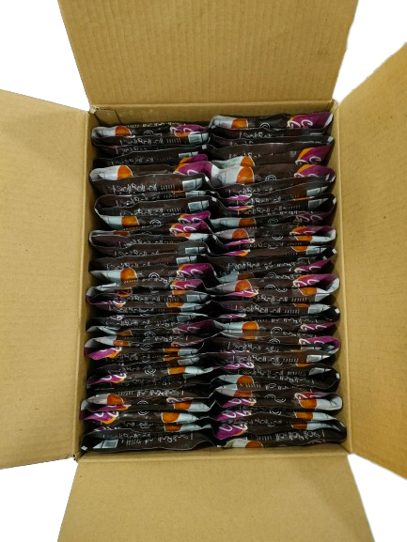
Café Gusto
Packaging Format
(Clasico)
Café Gusto Clasico
60’s x 3
180pcs per box

Slide 21
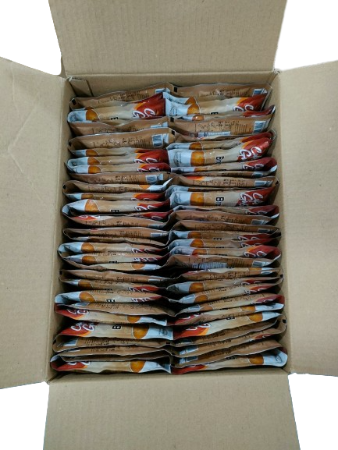
Café Gusto
Packaging Format
(Brown)
Café Gusto Brown
60’s x 3
180pcs per box

Slide 22
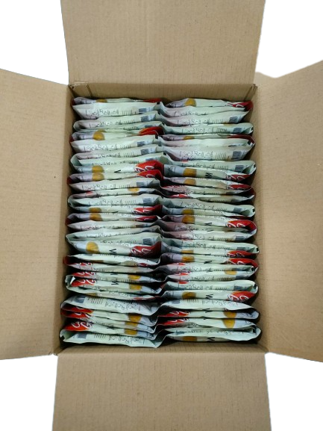
Café Gusto
Packaging Format
(White)
Café Gusto White
60’s x 3
180pcs per box

Slide 23
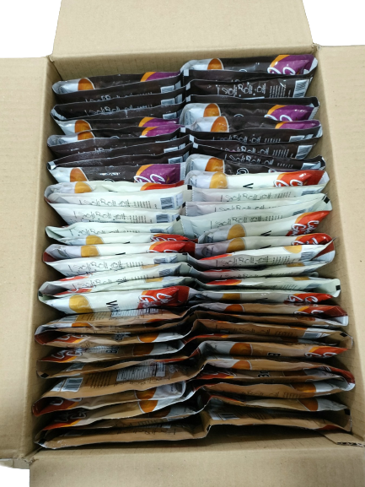
Café Gusto
Packaging Format
(Assorted)
Café Gusto Assorted
60’s per variant x 3
180pcs per box

Slide 24
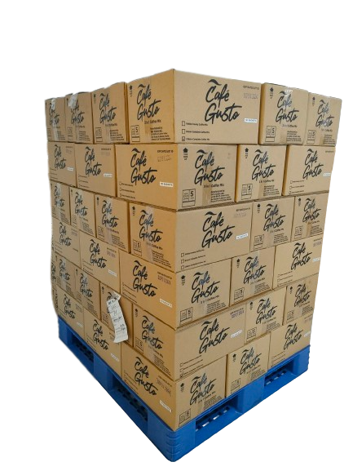
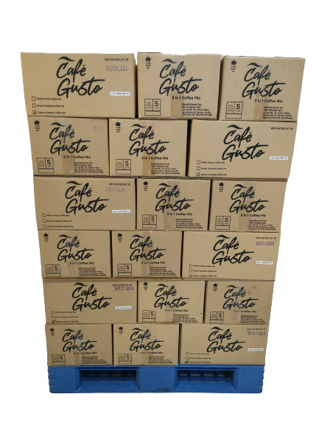
Café Gusto
Packaging

Slide 25
Facilities

Slide 26
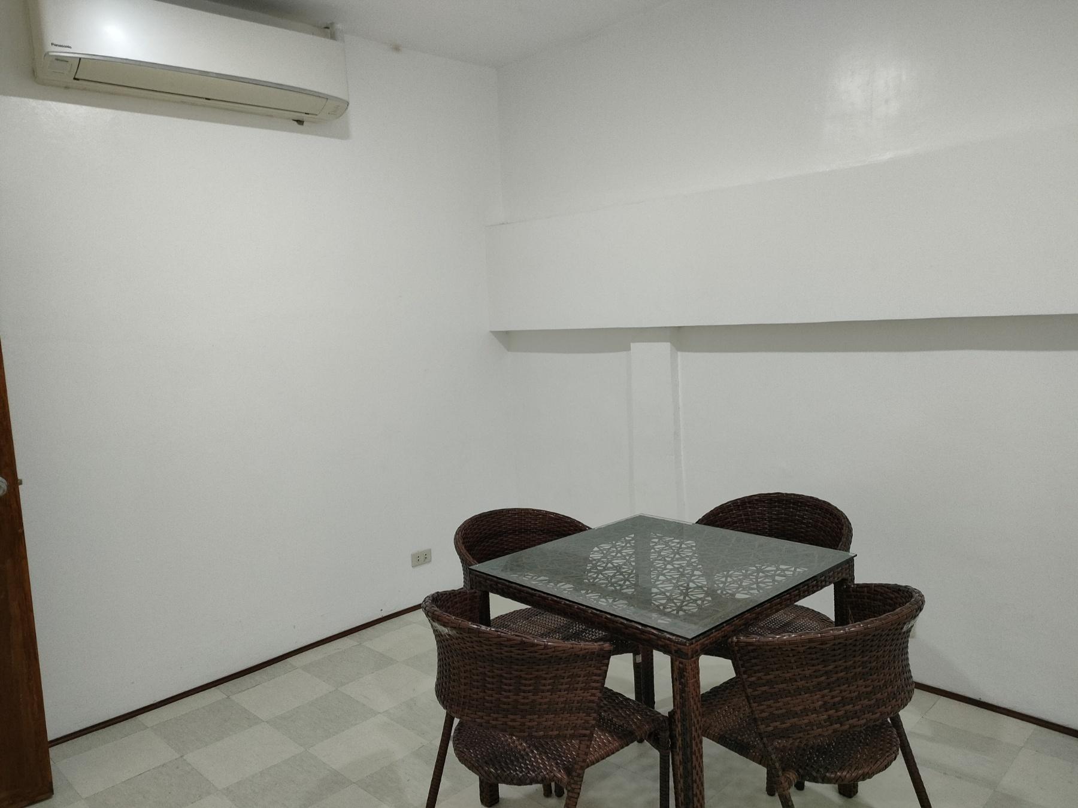
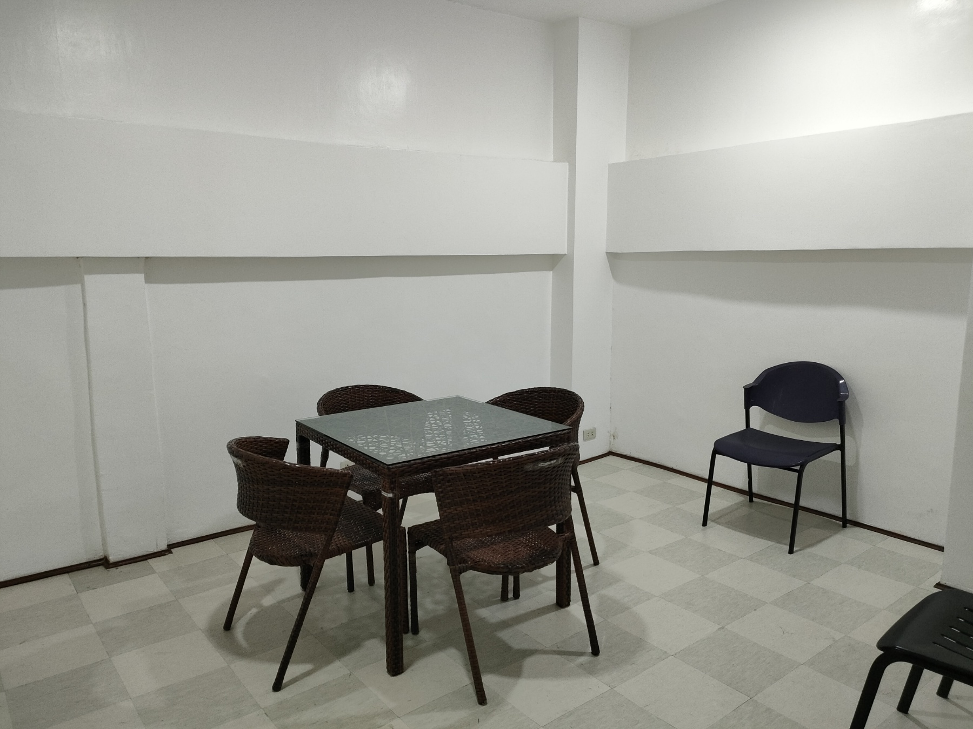
Conference Room

Slide 27
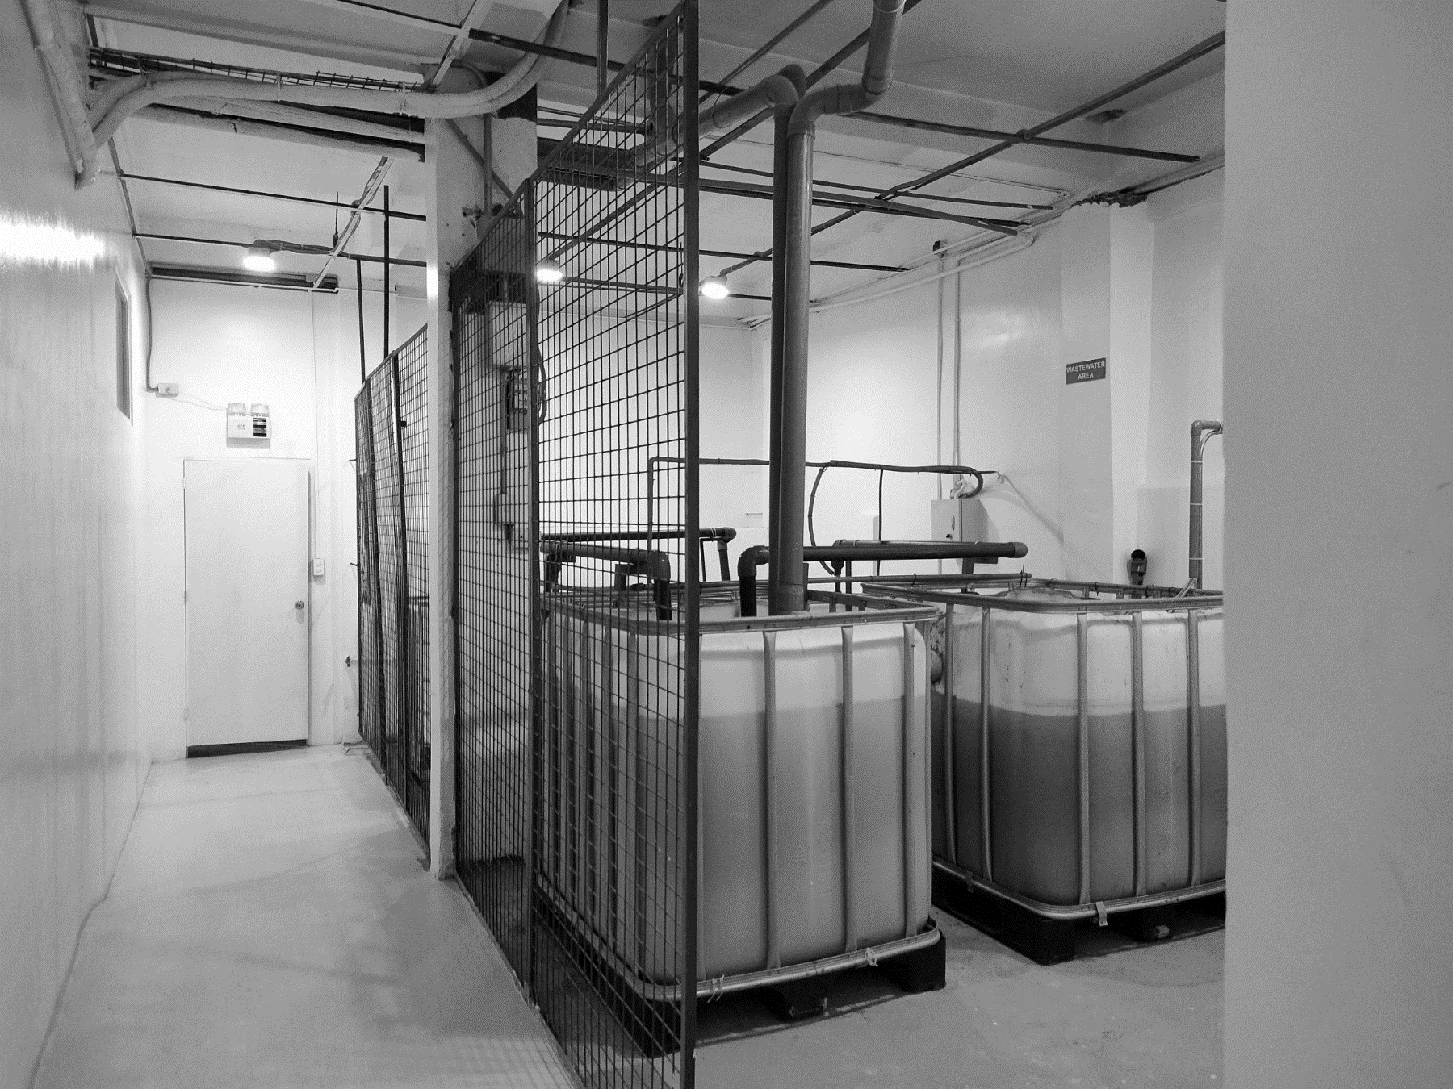
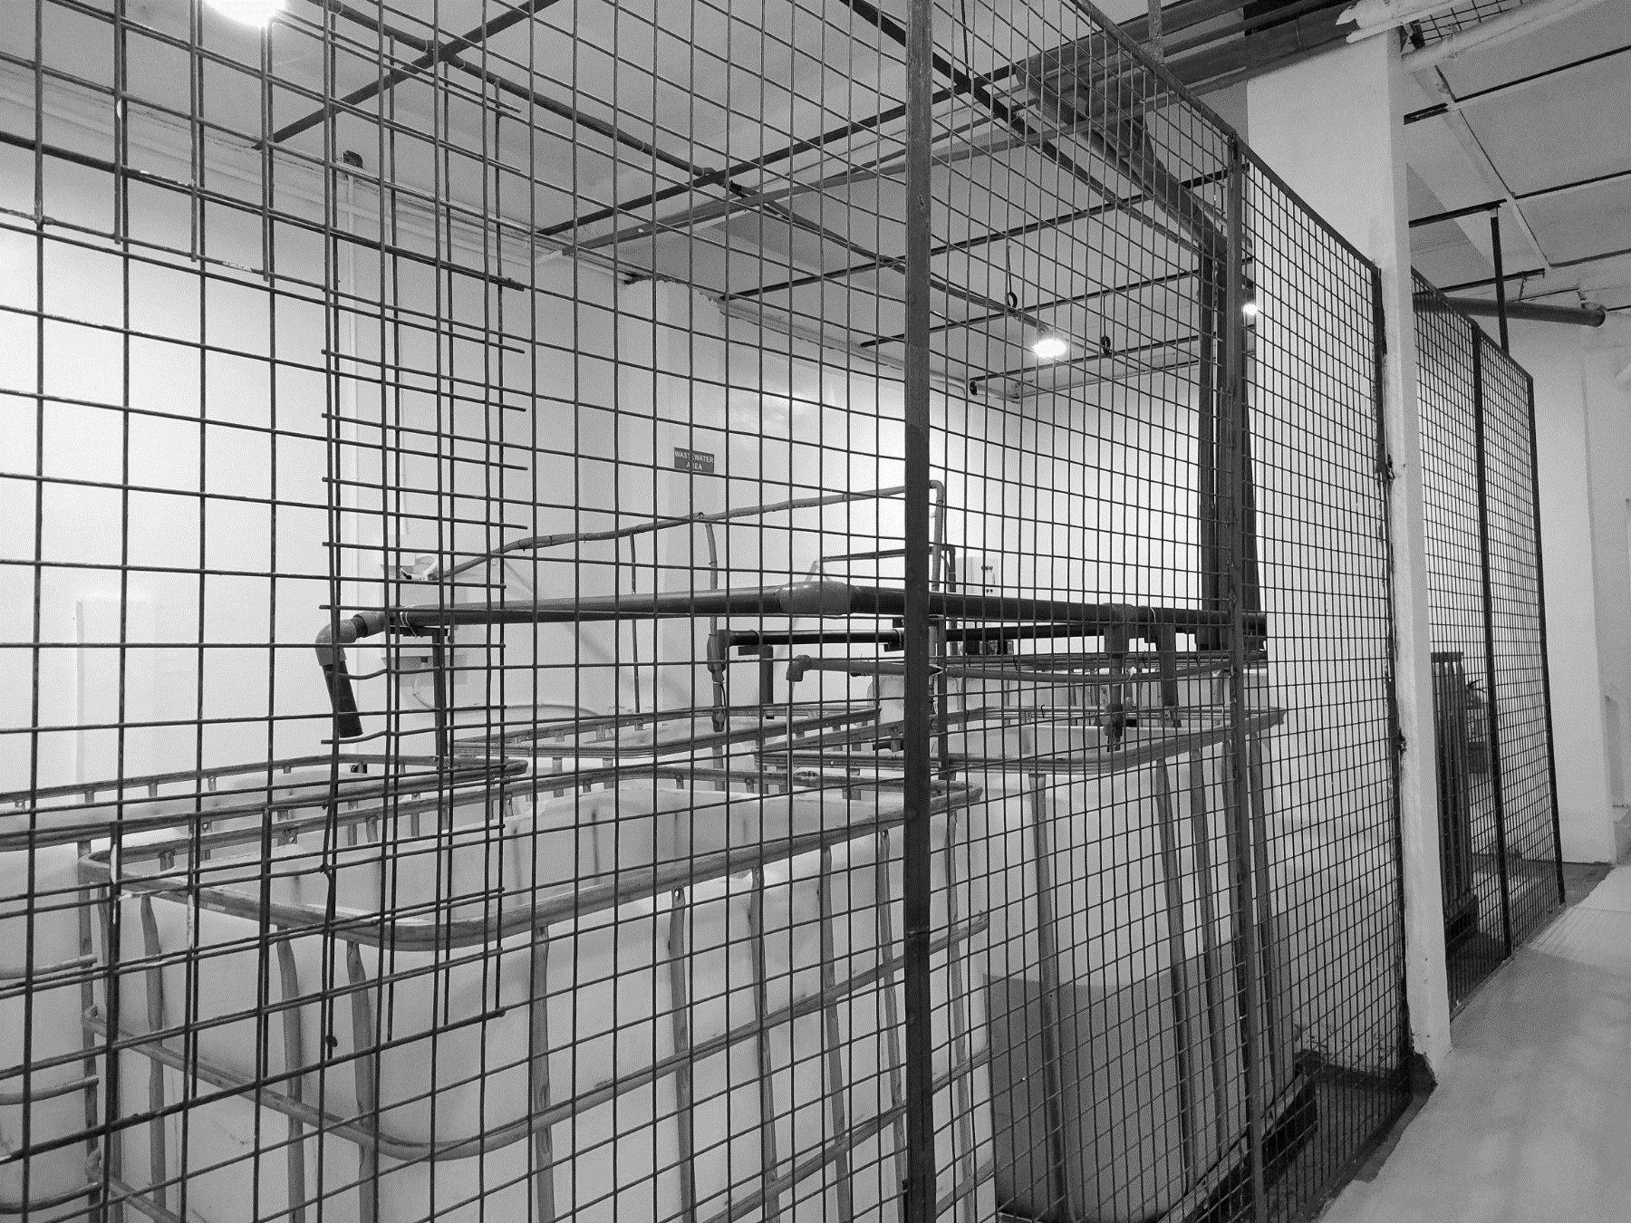
Wastewater Treatment

Slide 28
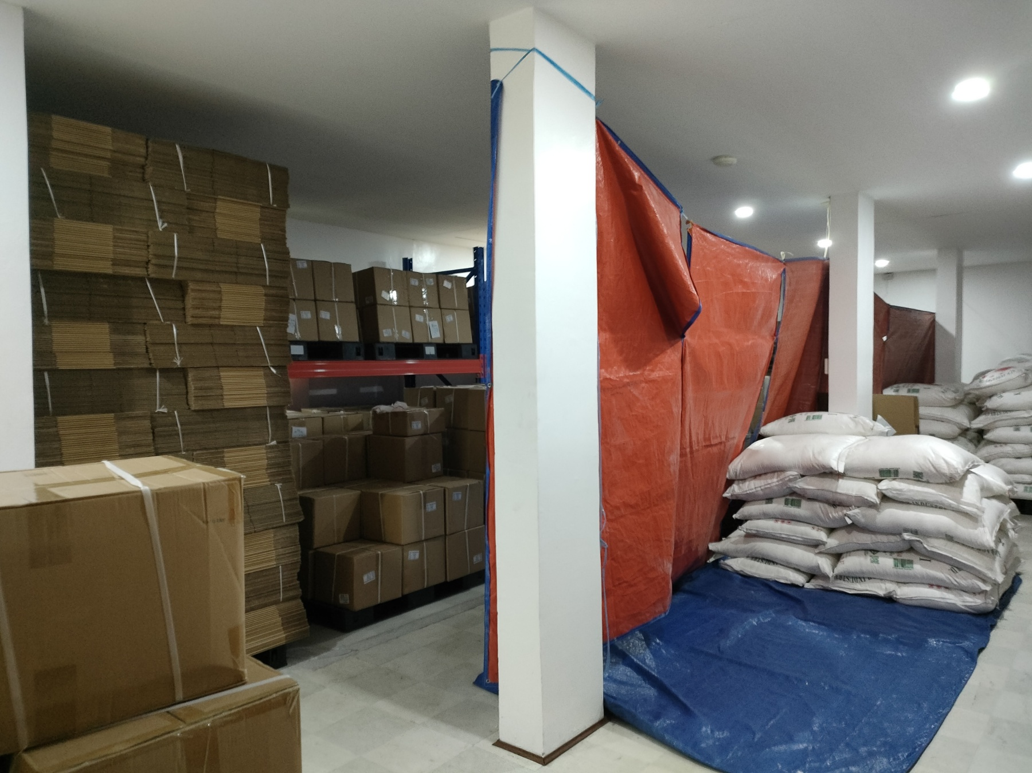
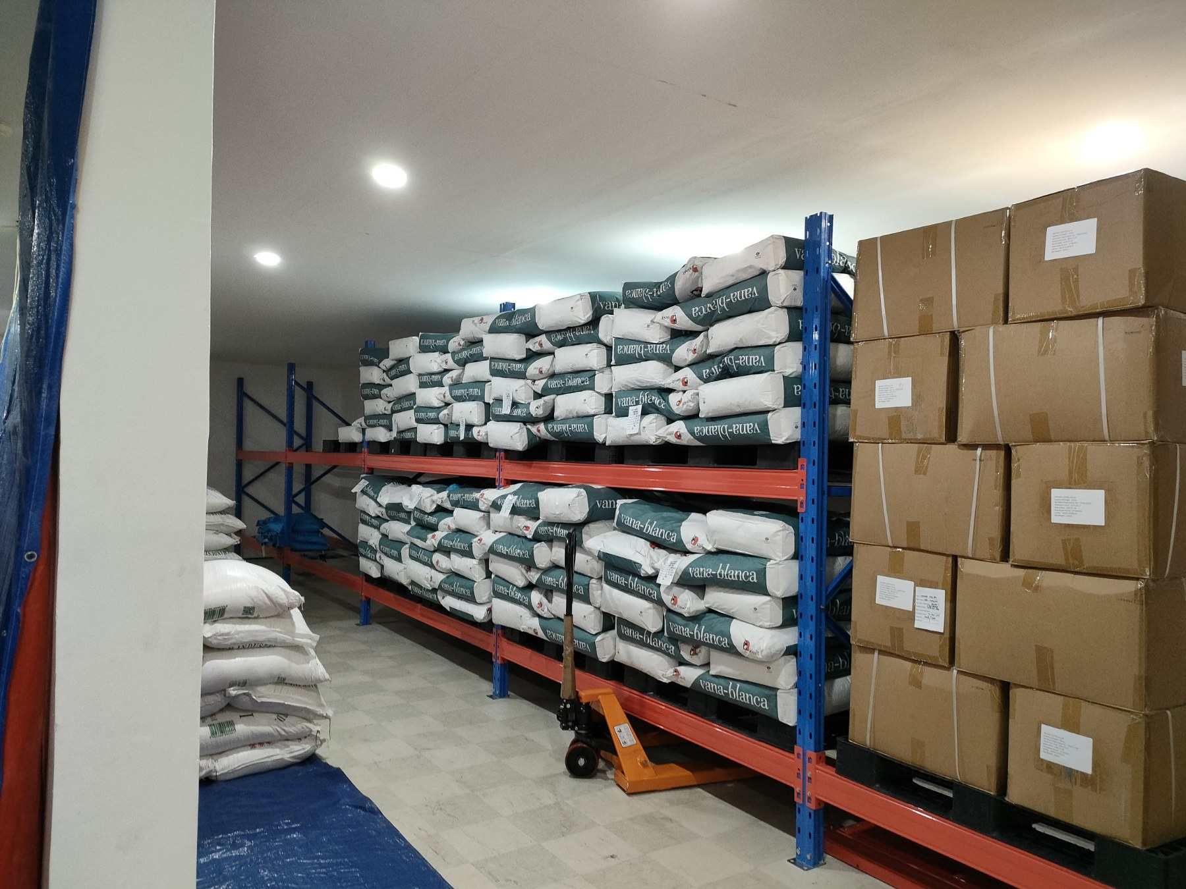
Warehouse

Slide 29
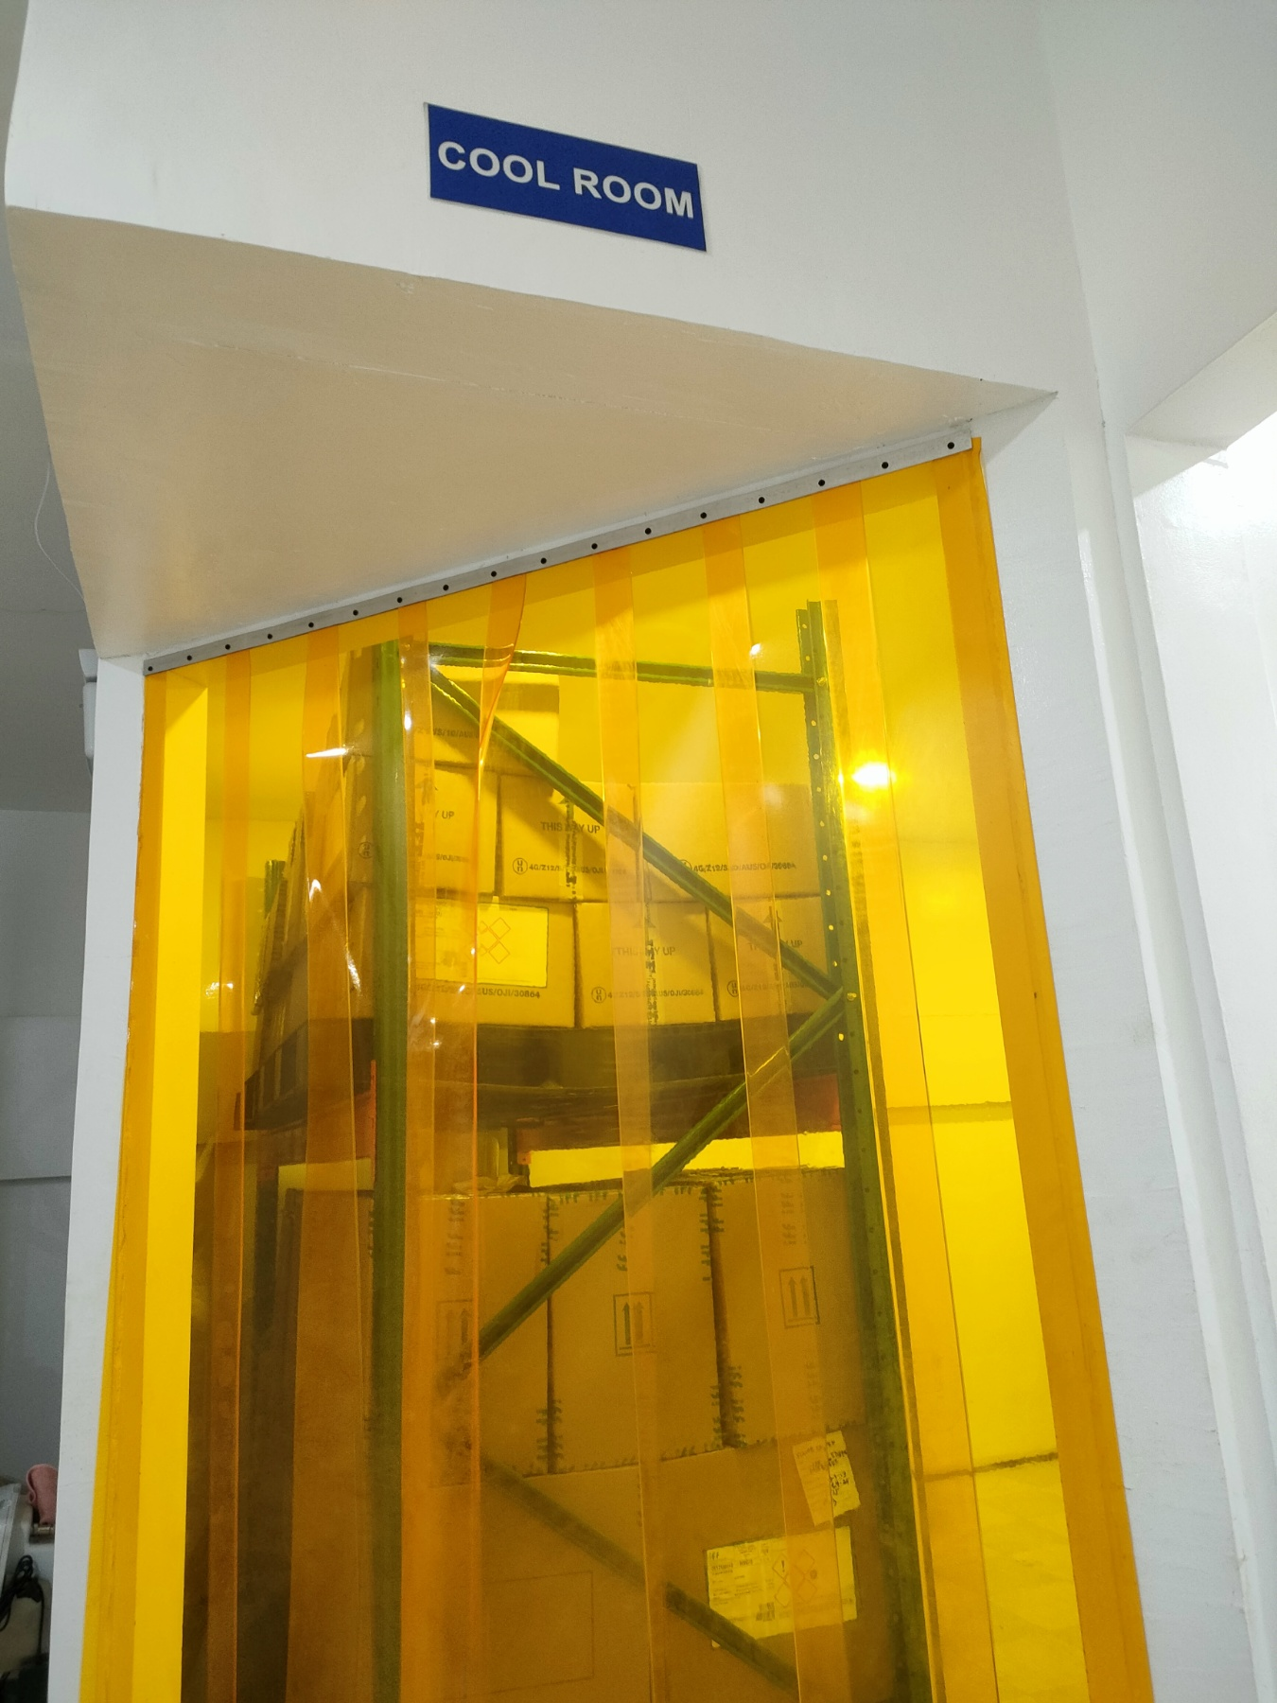
Cool Room

Slide 30
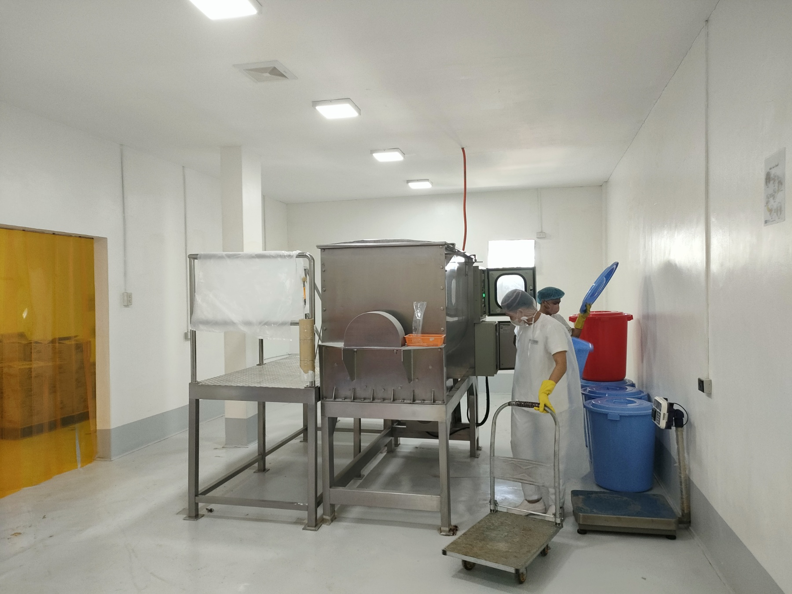
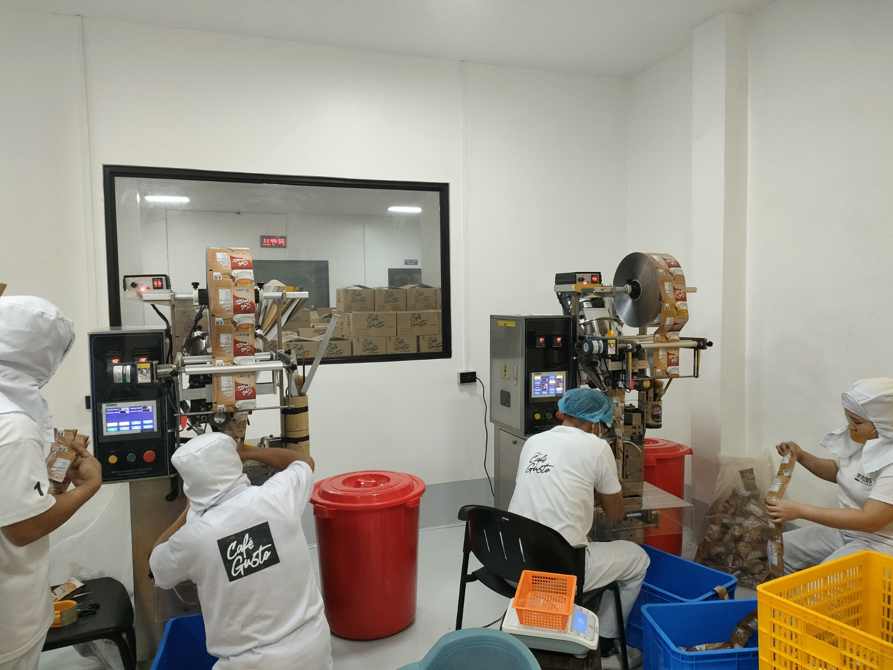
Production Area

Slide 31
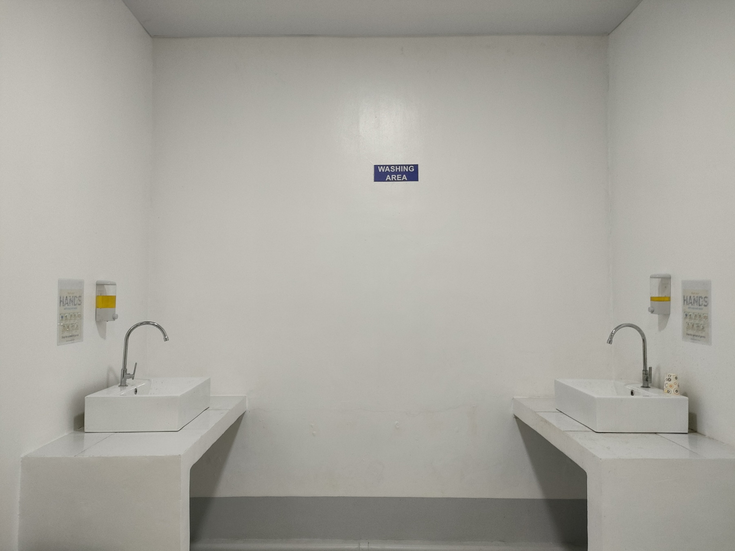
Washing Area

Slide 32
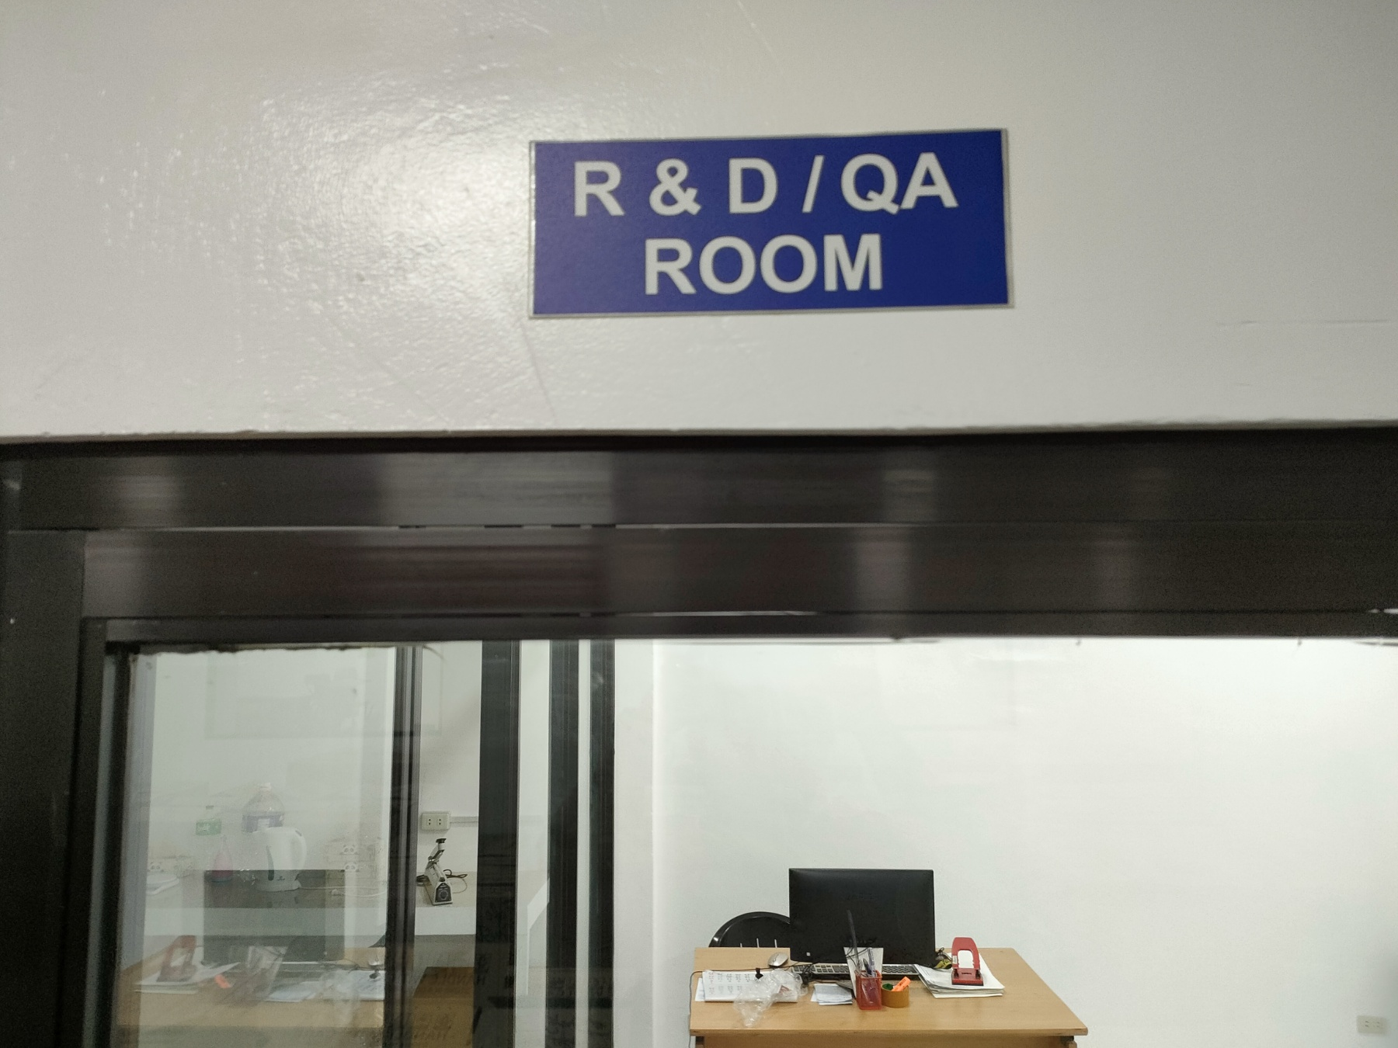
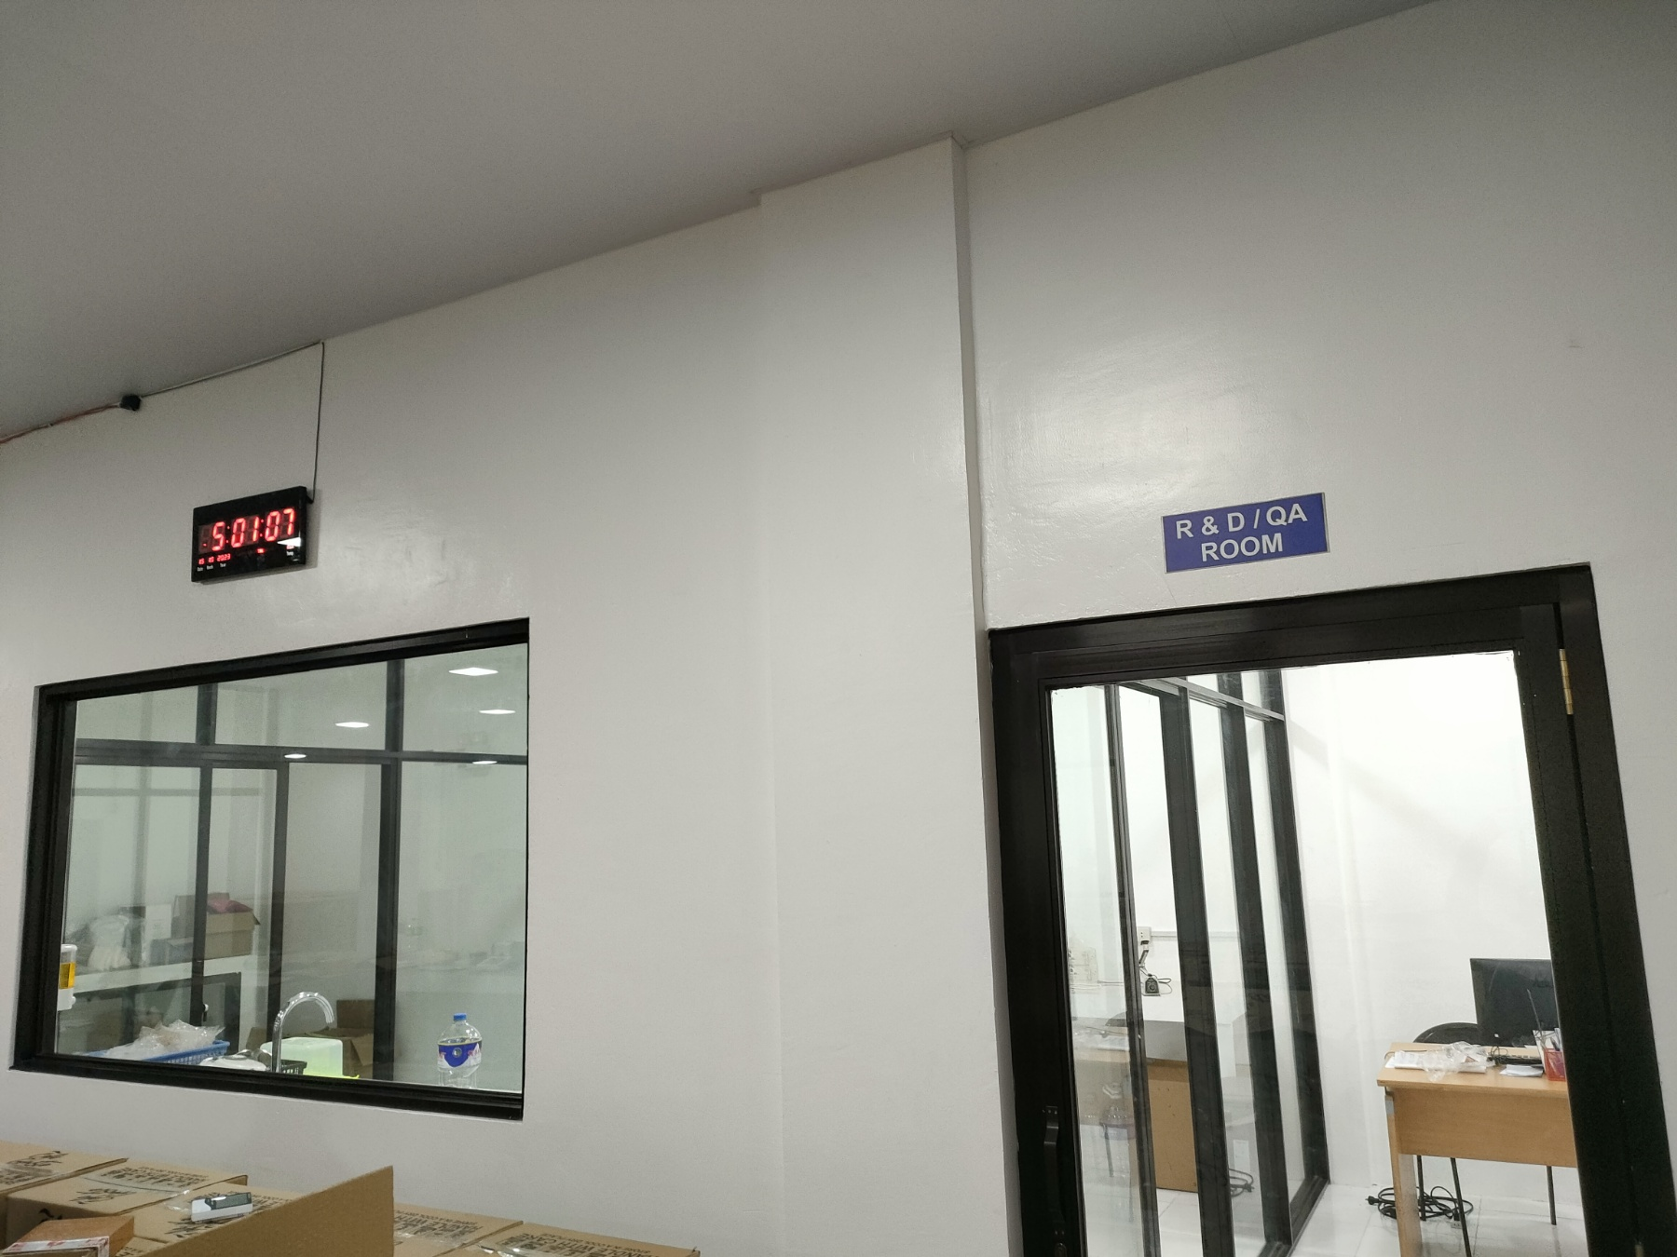
R&D / QA Office

Slide 33
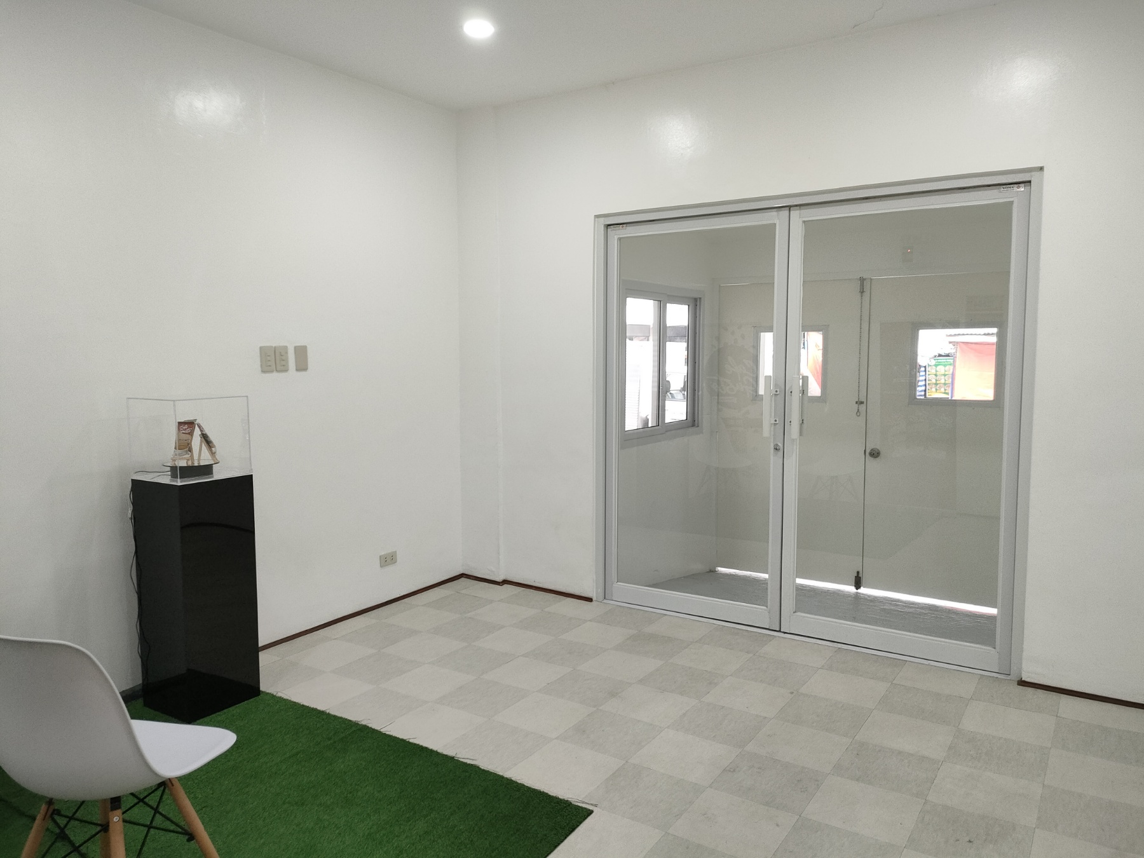
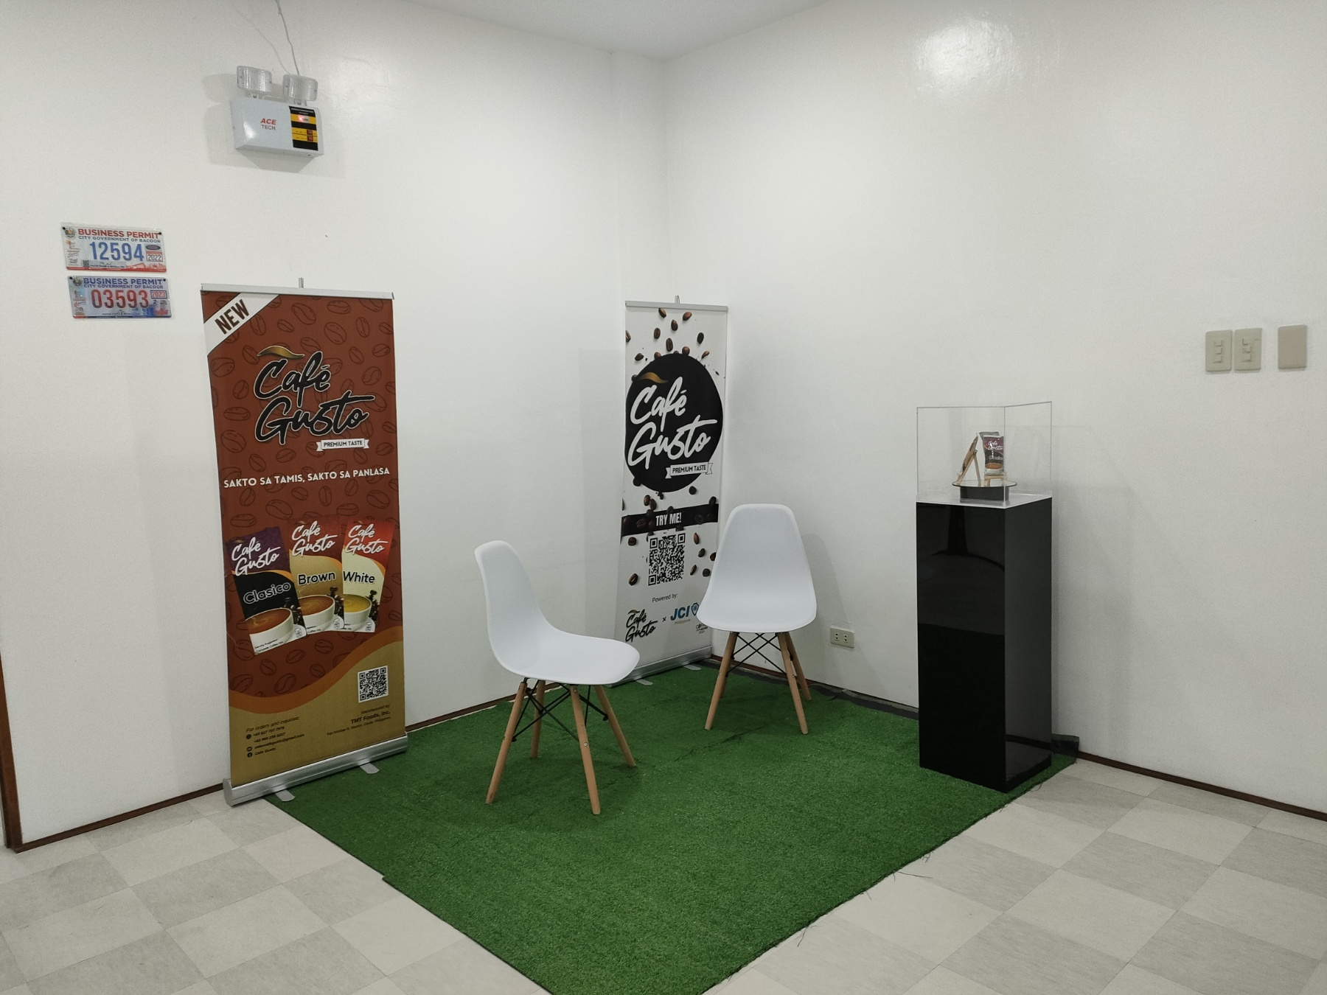
Reception

Slide 34
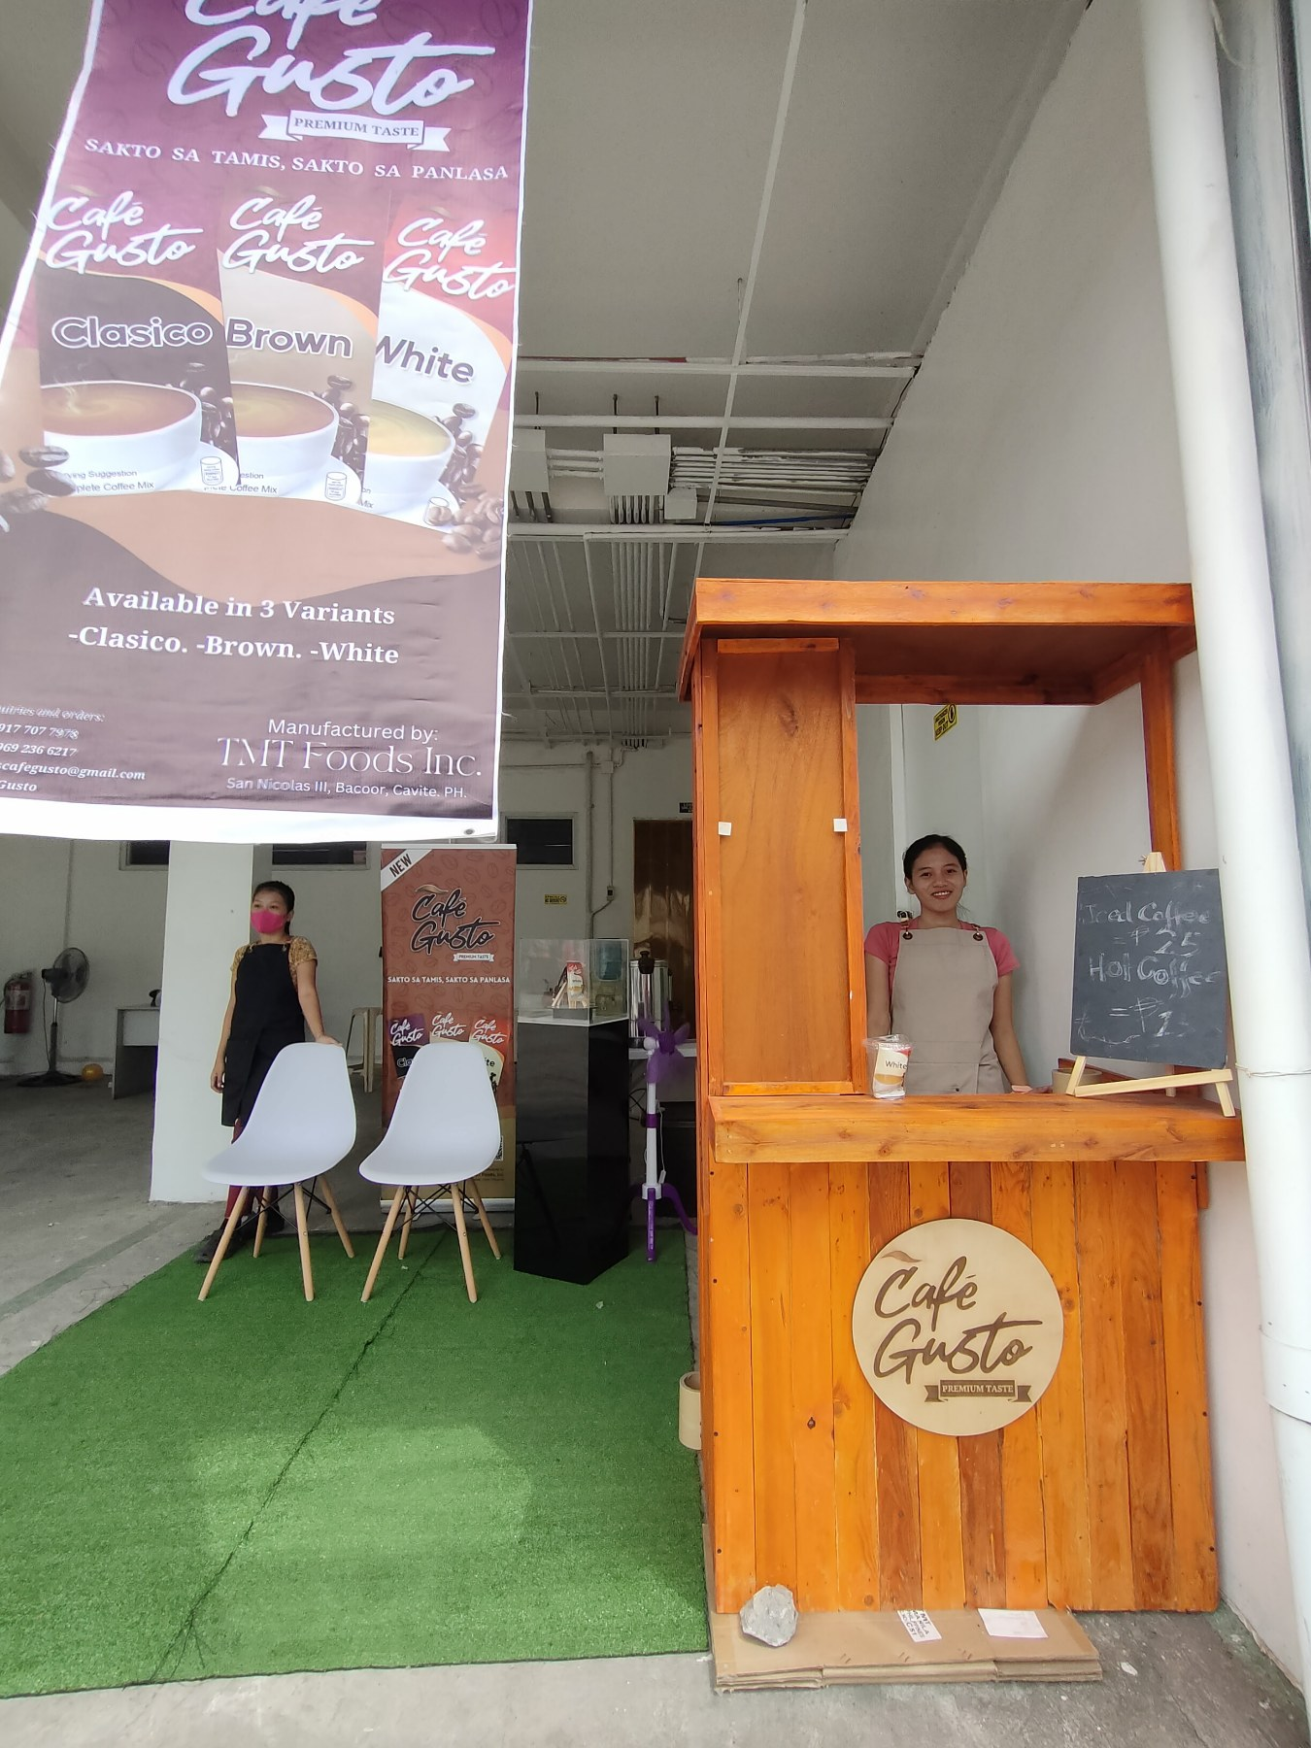
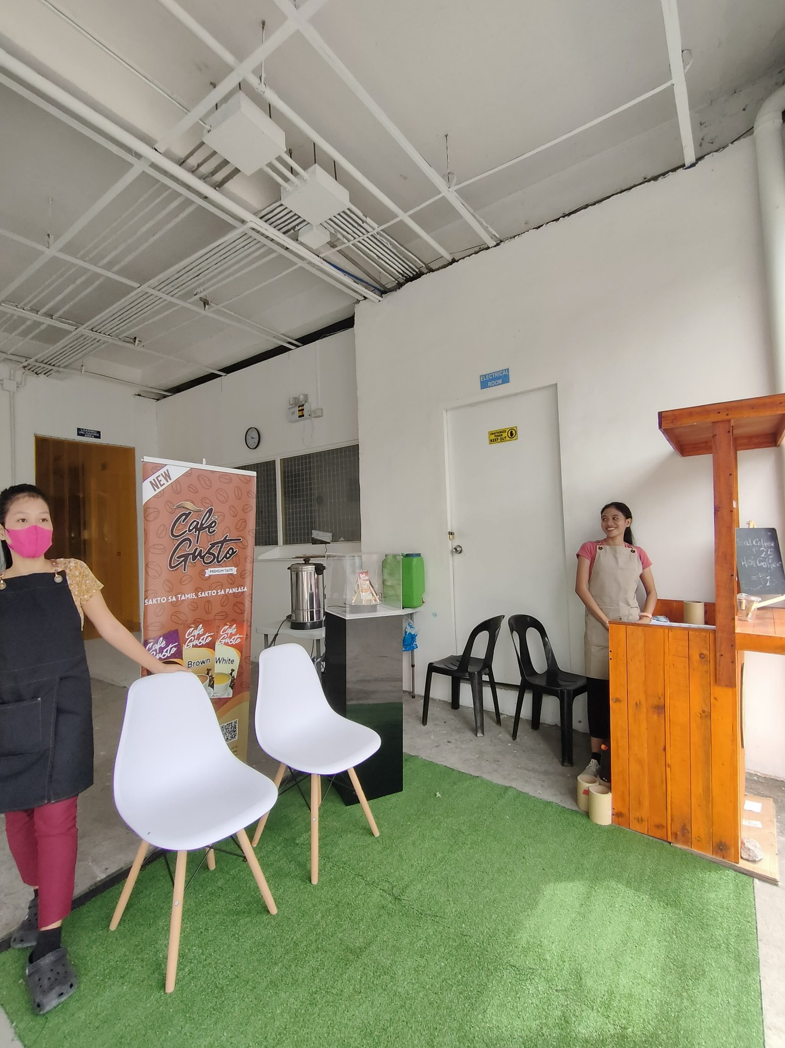
Café Gusto Booth

Slide 35
Permits and Licenses

Slide 36
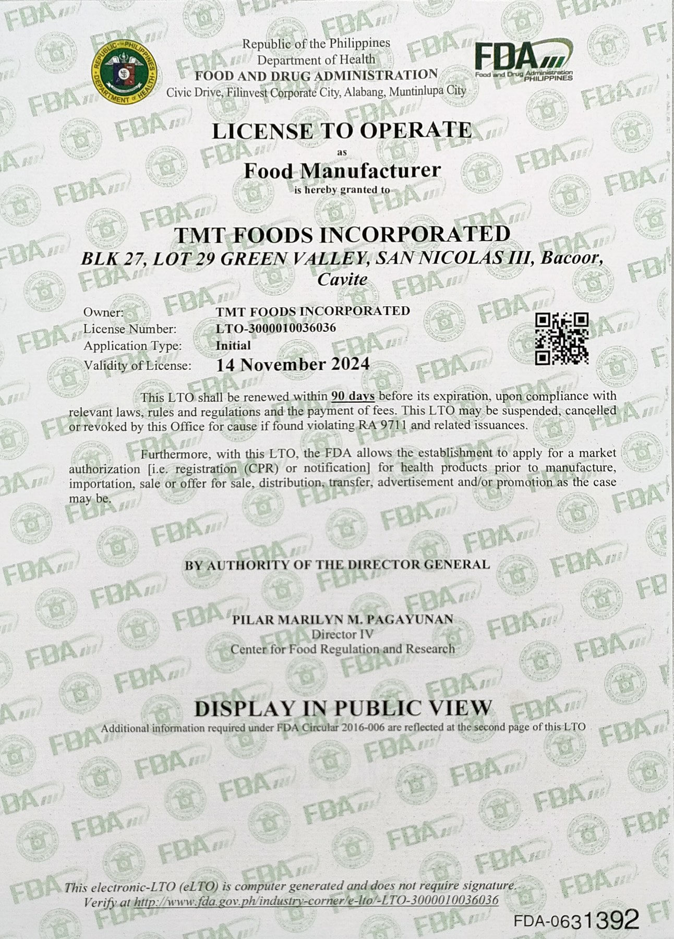
Permits and Licenses

Slide 37
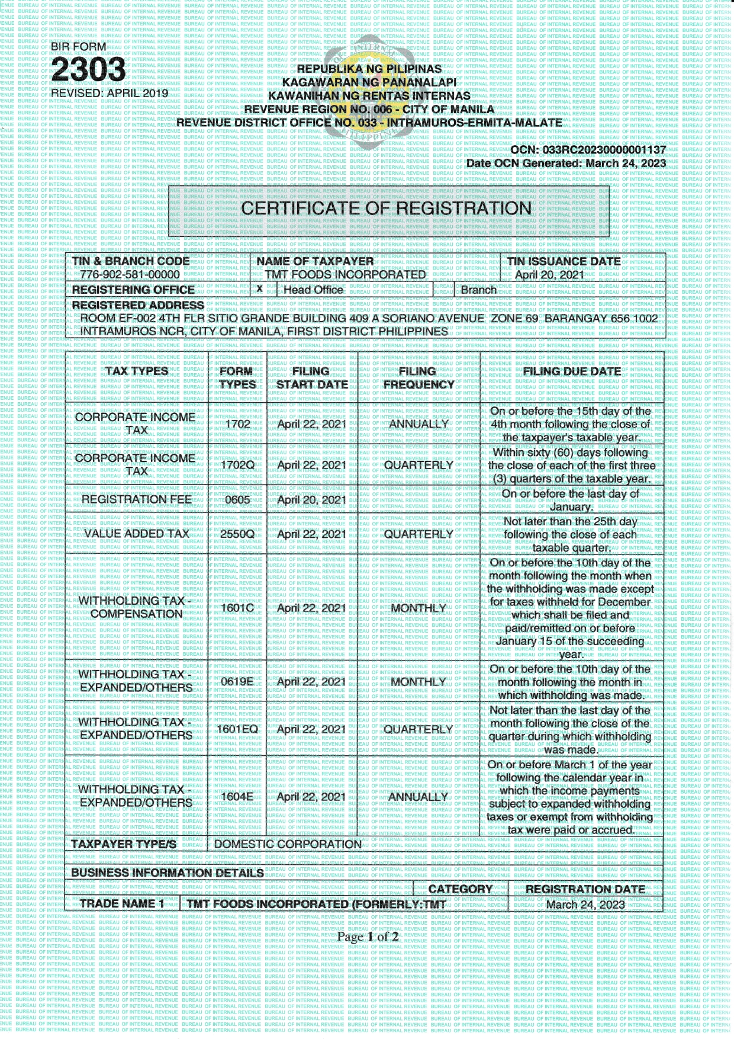
Permits and Licenses

Slide 38
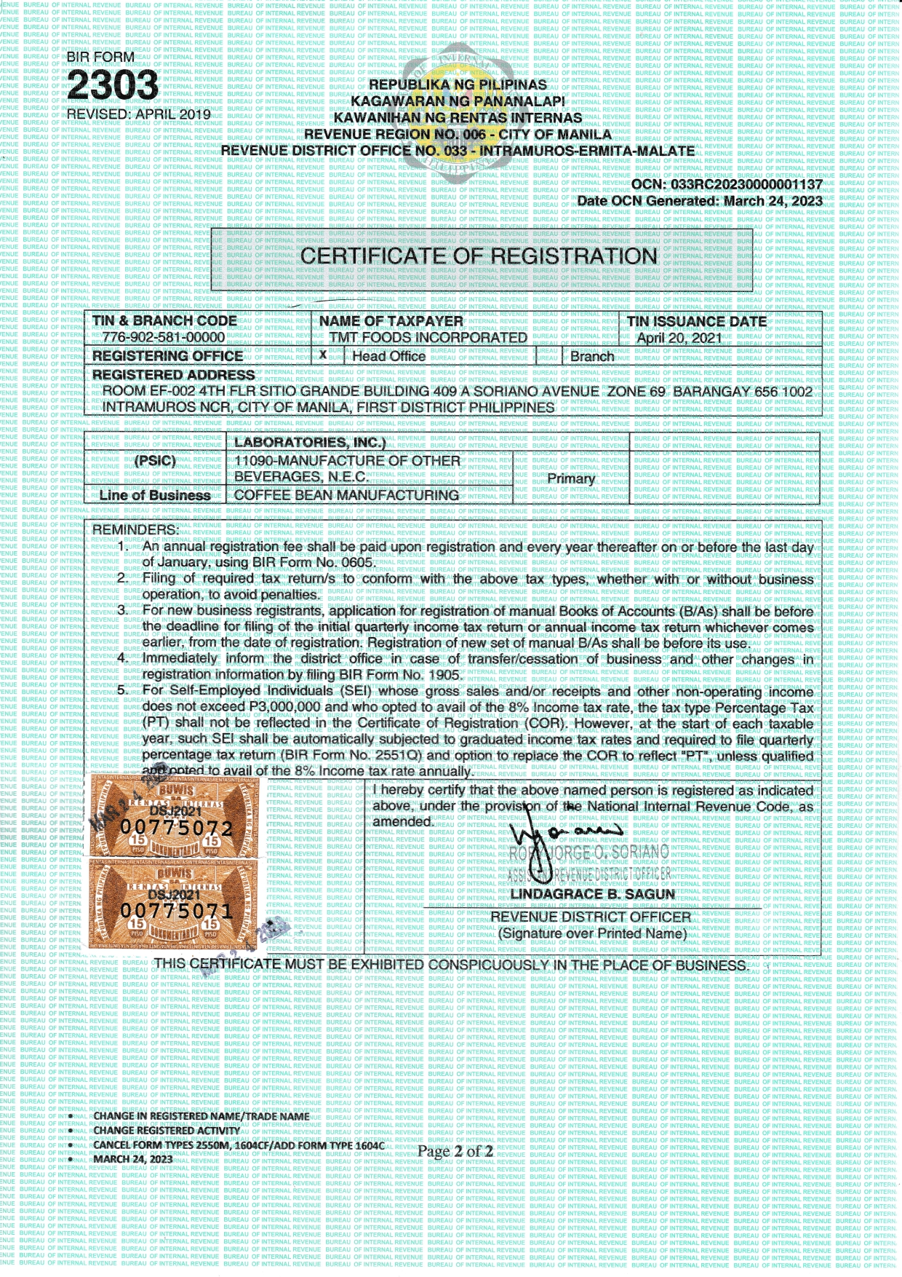
Permits and Licenses

Slide 39
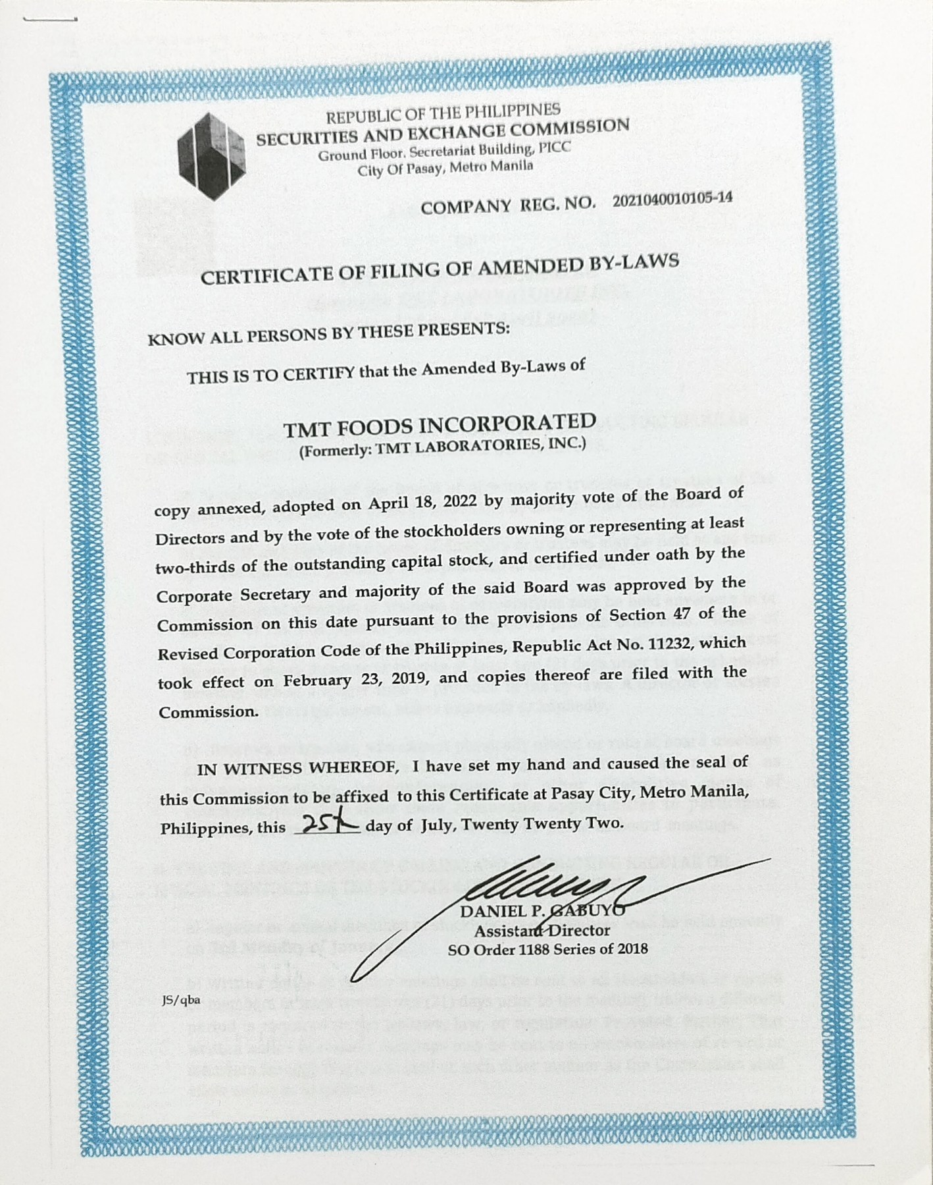
Permits and Licenses

Slide 40
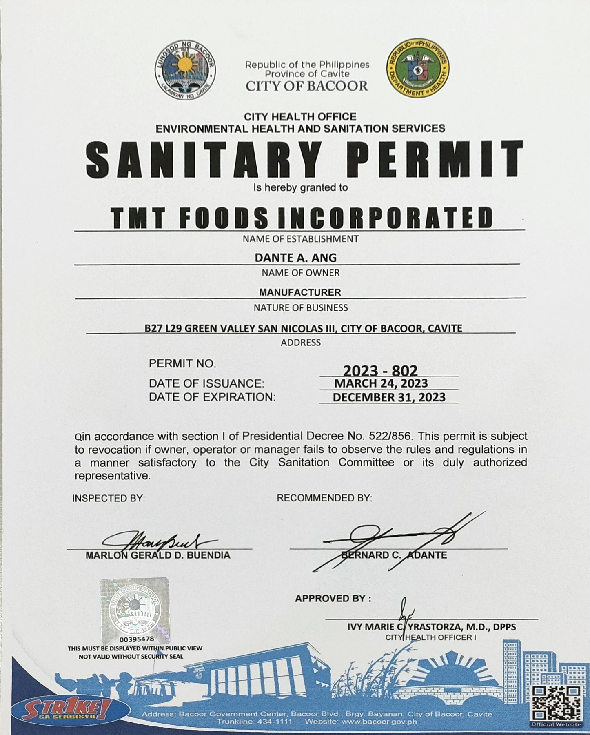
Permits and Licenses

Slide 41
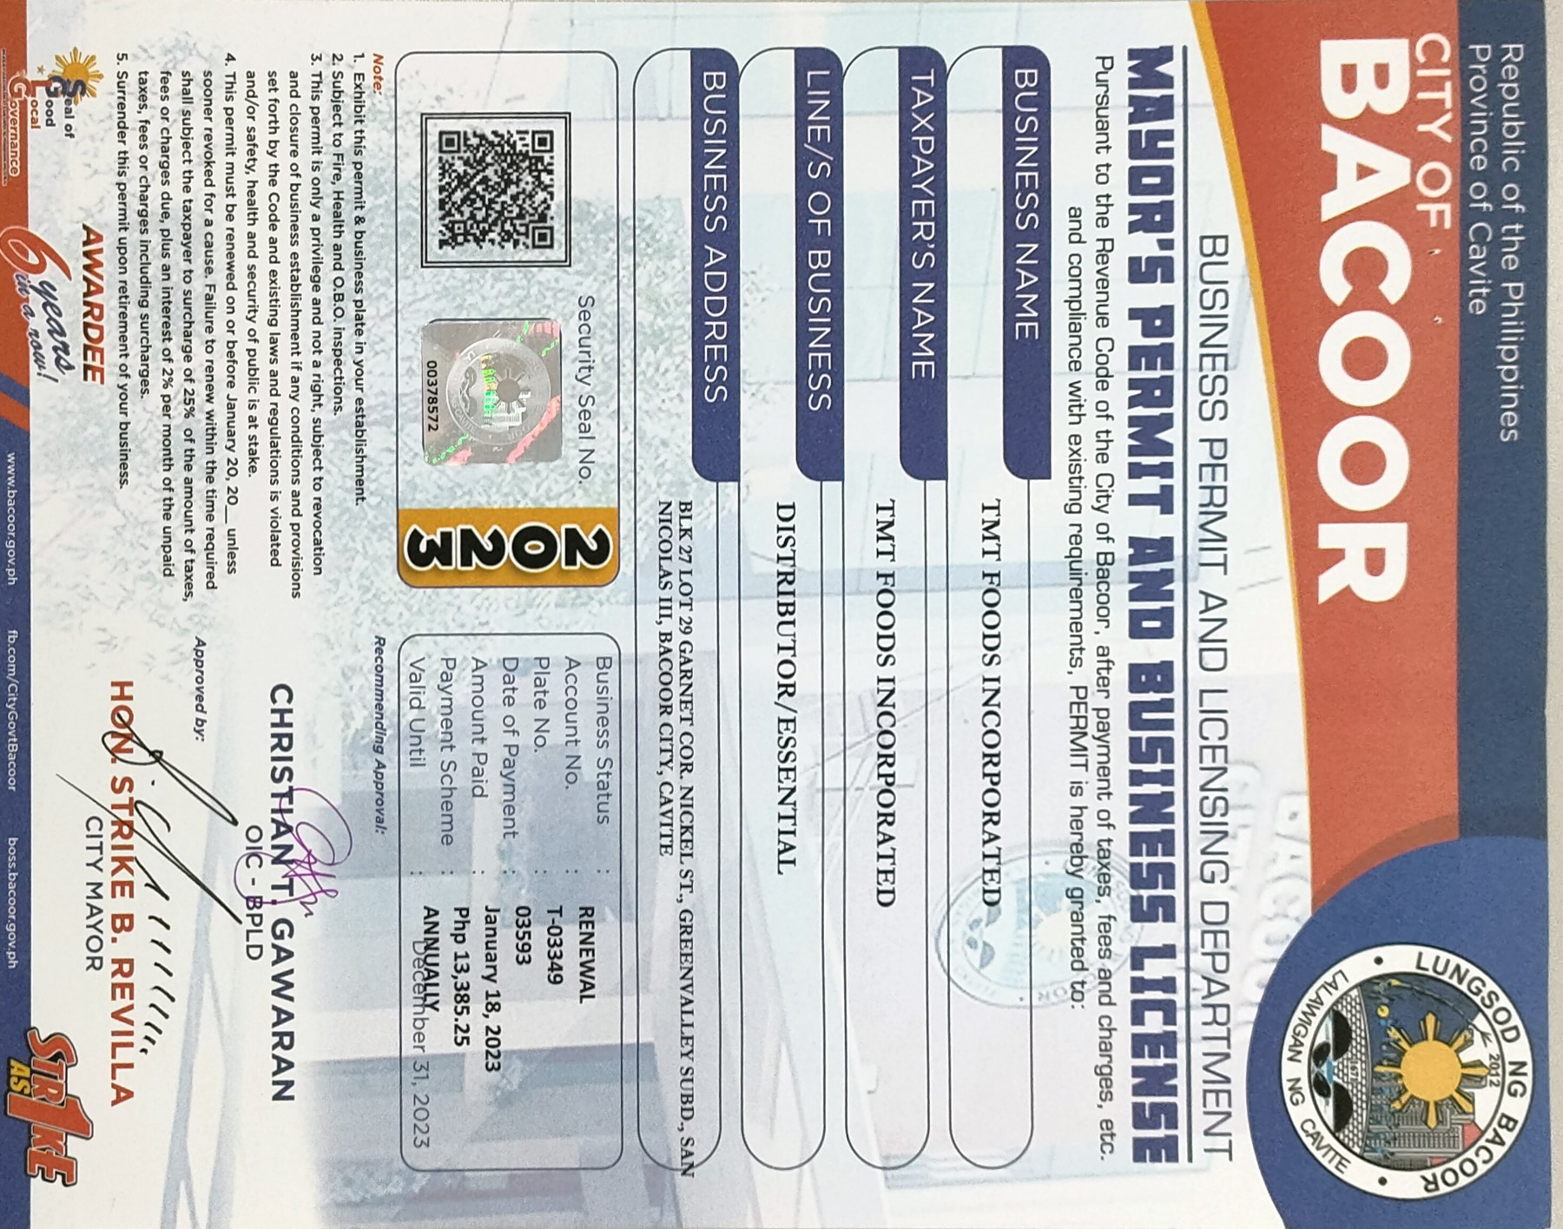
Permits and Licenses

Slide 42
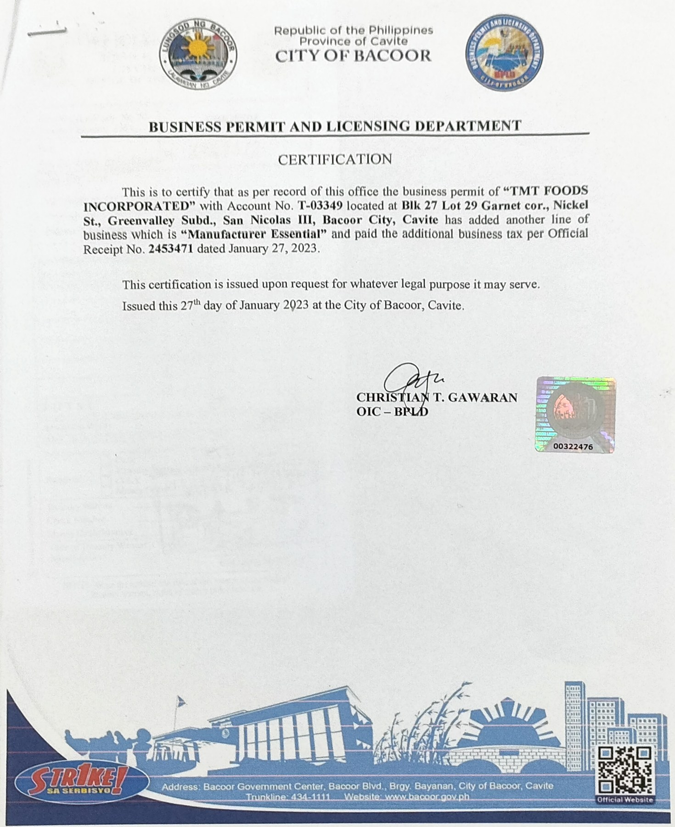
Permits and Licenses

Slide 43






Contact Us!
For Inquiries and Orders.
+63917 707 7978
Cafe Gusto
@cafegusto01
@cafegusto01
www.tmtfoods.ph

